Slide 1
Reconstructing Audio From Video
Rishi Kapadia
Baladitya Yellapragada
CS 294-127 Final Project

Slide 2
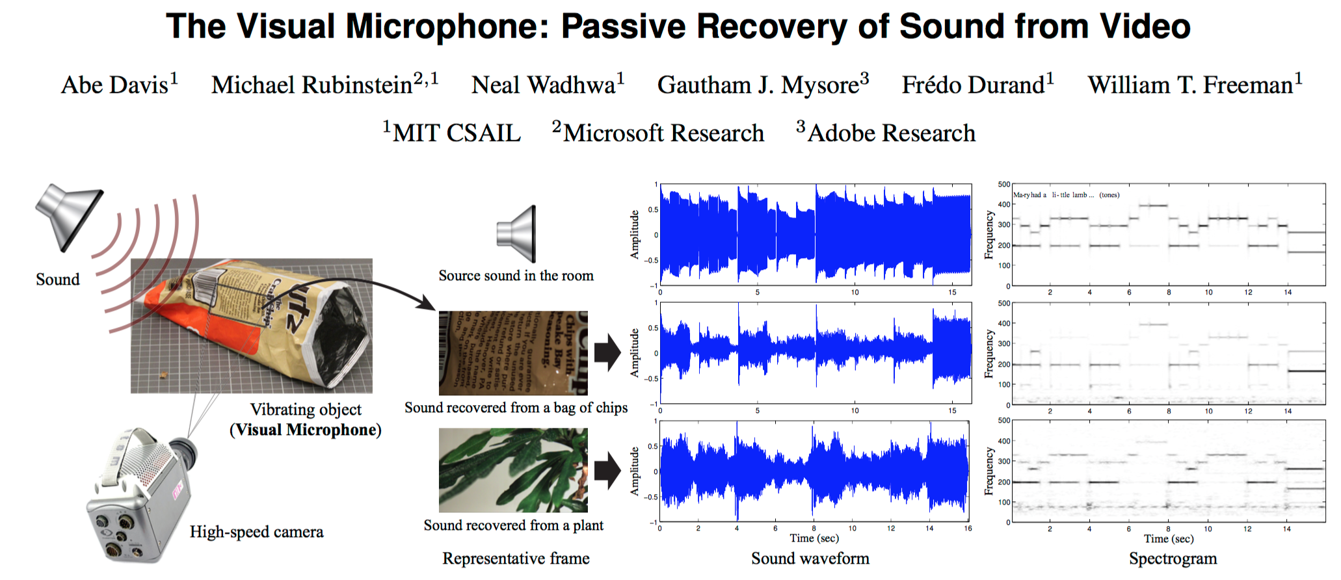
Motivation
Based on Eulerian Video Magnification framework by the CSAIL research group at MIT
Notes:
Our original idea was to use a high-speed camera to recover speech audio from a video of someone’s throat while they are talking. To start off, and to ensure more consistency between experiments, we decided to videotape a base speaker as it is playing music.

Slide 3
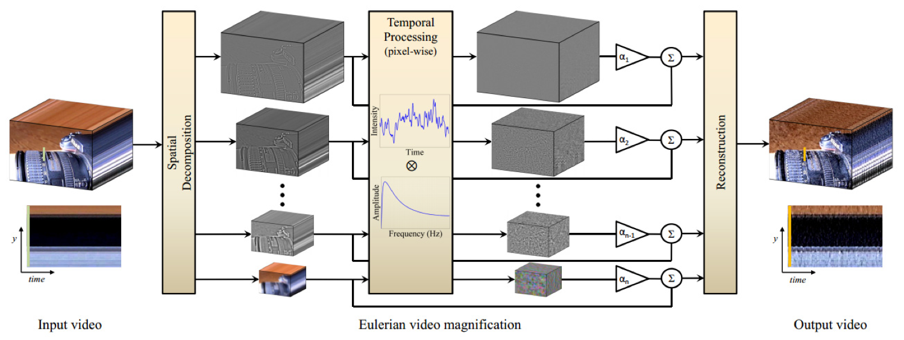
Eulerian Video Magnification
http://people.csail.mit.edu/mrub/vidmag/
Notes:
Here is some background into the series of papers on Eulerian Video Magnification. They attempted to decompose a high-speed video both temporally and spatially, filter each pixel in the decomposed video temporally to capture a certain range of frequencies, and then add that filtered signal times alpha back to the original decomposition, and collapse the decomposition into an amplified video.

Slide 4
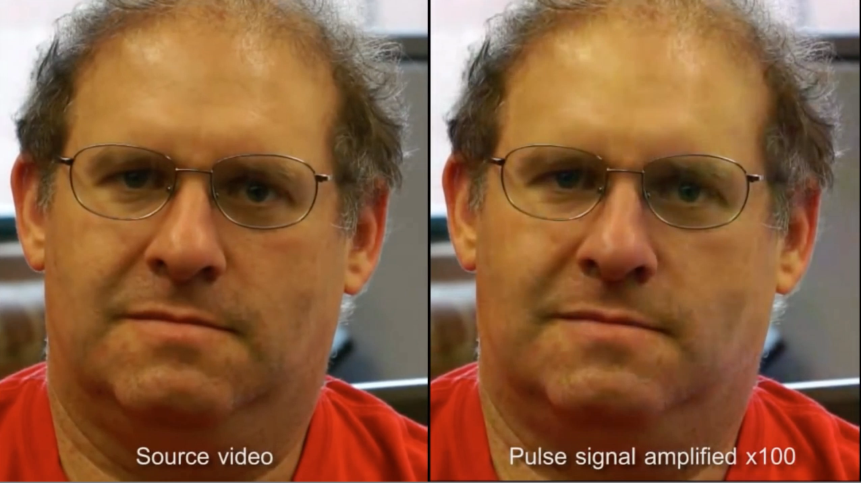
Amplifying Color Variations
http://people.csail.mit.edu/mrub/vidmag/
Notes:
Here is one result of amplifying color variations using that technique.

Slide 5
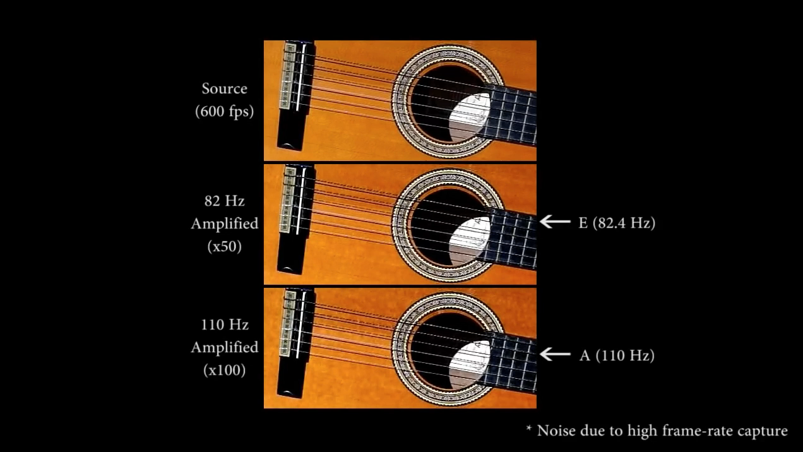
Motion Magnification
http://people.csail.mit.edu/mrub/vidmag/
Notes:
Here is another example where they use different cutoff frequencies in their temporal filters to amplify spatial motions for certain frequencies, namely the first and then the second strings of the guitar, respectively.

Slide 6

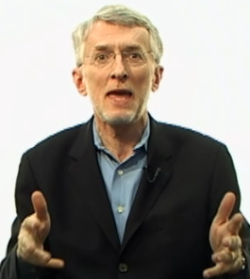
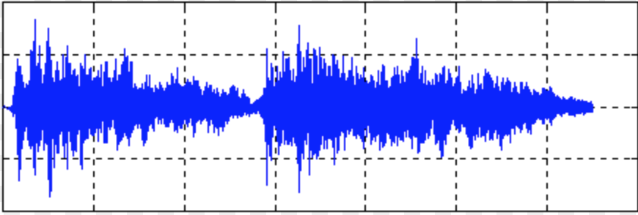
Audio Reconstruction
http://www.niemanlab.org/images/jeffjarvisvideo.png
Notes:
Since we want to reconstruct the audio signal only, and not amplify and display the variations in the original video, we do not need to do a spatial decomposition of our input video. Instead, we propose to take a high speed video of someone’s throat while they are talking, look at the pixel with the largest amplitude difference, and then filter that 1D signal over time to recover the audio of the person speaking. We realize that just looking at the throat alone may not convey syllables, which would require also looking at the embouchure of the tongue and mouth, but we at least wanted to see if we can recover the pitch of the voice. This is different from the Visual Microphone experiment conducted by CSAIL because we are analyzing a video of an audio source, instead of an indirect, malleable, or passive object in the environment.

Slide 7
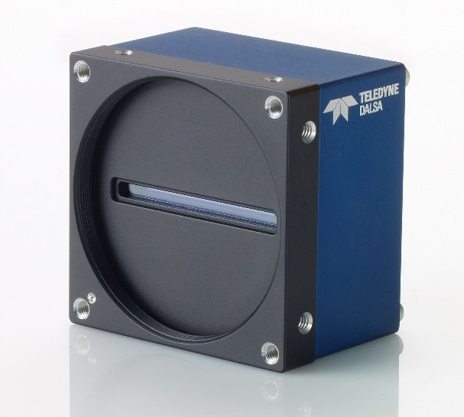
Experimental Setup
Spyder3 1k, 36 kHz GigE
Monochrome line scan camera
Bass speaker
LED flashlights from our mobile phones
Alternative to flickering from fluorescent lightbulbs
Audacity to generate audio clips of single and multiple frequencies

Slide 8
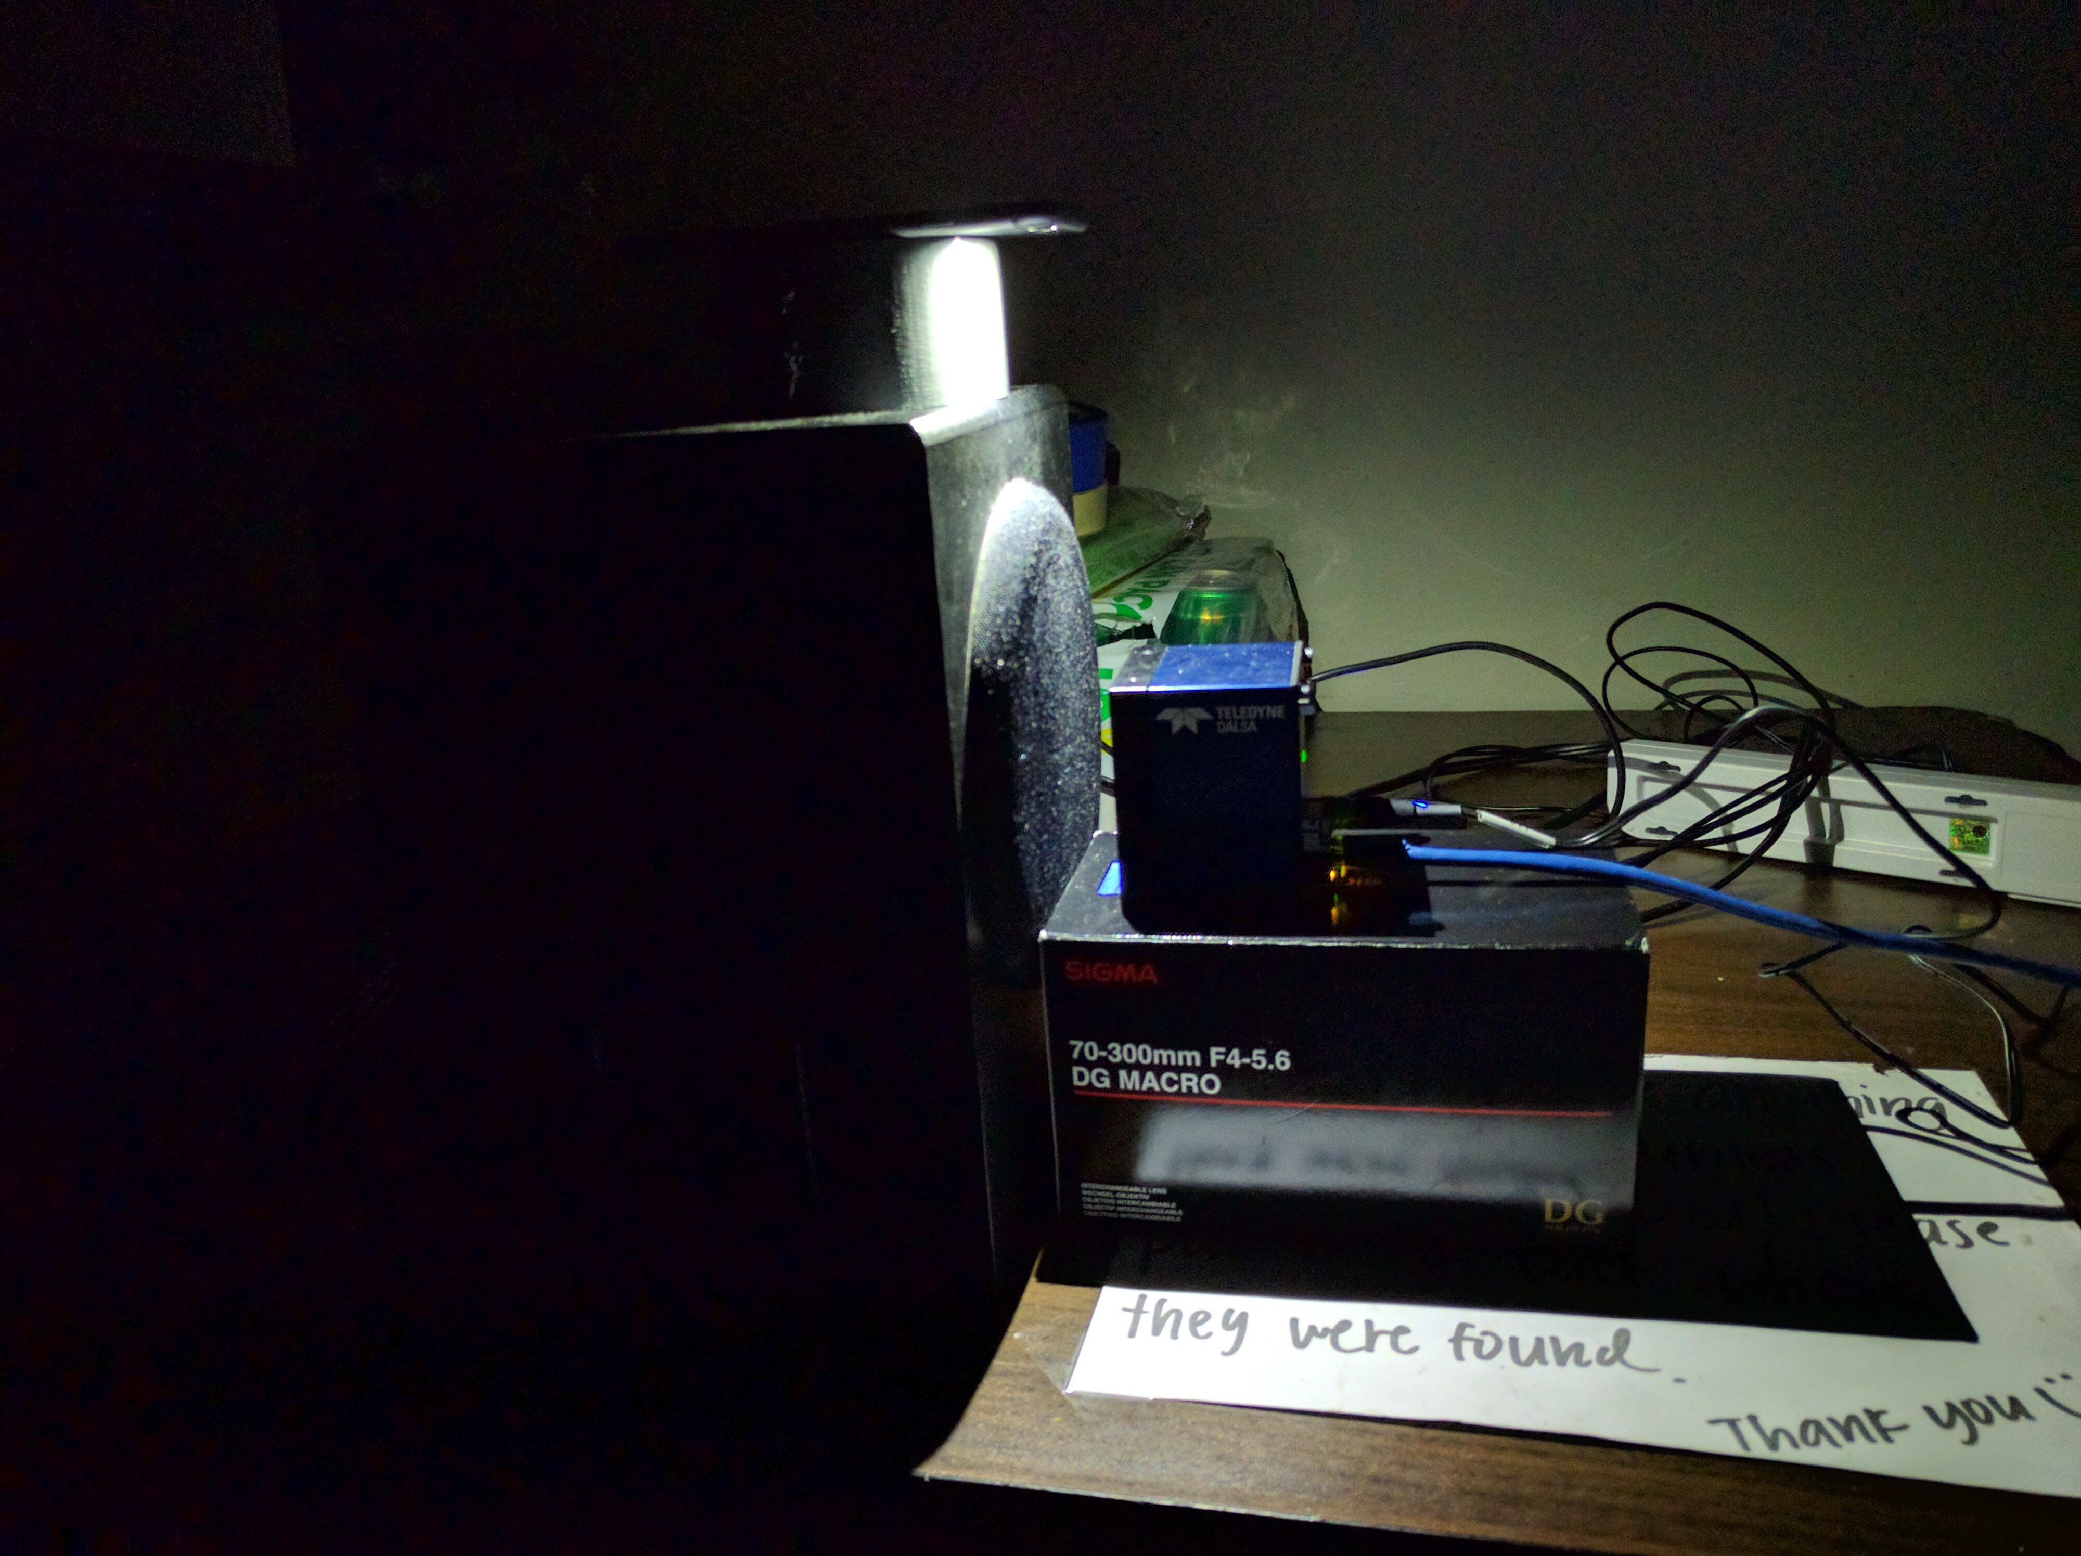
Experimental Setup
Notes:
After much trial and error, this is what we found was the best setup. We even bought a high powered lens and lens adapter for the line-scan camera, but using the lens did not work well for several reasons, including:
With the lens, not enough light was bouncing off of the speaker and straight into the lens to the camera sensor.
It was very hard to determine if the camera was focused, because we didn’t have a 2D high-speed camera.

Slide 9

1D Camera Output
50 Hz Audio Signal
Notes:
Here is an example of the 2 seconds of video that we can record at a time. The base speaker is playing a 50 Hz audio signal.

Slide 10
Problems We Faced
Working with the default software
Saving the camera’s video stream to a file
Setting the camera to the highest framerate possible
Software that would let us do the above costs $1000, had to find workarounds
Issues with the lens and lens adapter
Focus issues, with a 1D camera
1D camera not very sensitive to higher frequency oscillations, due to lack of focus
Lighting changes
Fluorescent lights had an oscillating signal by itself
Natural light had no oscillations, but sunlight intensity changes frequently
Lots of noise for several signals
Notes:
We encountered several problems along the way.
- Saving the camera’s video stream to a file
---- Workaround was to record only 2.45 seconds at a time
- Setting the camera to the highest framerate possible
---- Should theoretically be up to 36 kHz, but had to settle for about 10 kHz
---- Also tried to control the electronic shutter speed digitally, but we found it to not be possible
Lens issues: We bought the lens, but found out that it needed an adapter to fit onto the camera. The lens adapter is an old design and not available everywhere, but we managed to buy one from China. Also the 2 reasons we mentioned a couple slides ago, lighting and focus issues.
We found lots of noise for several of the signals we measured. We incrementally improved on the noise with changes to both our setup, such as replacing lightbulbs with natural light and then LEDs, and in our digital processing, with frequency thresholding, normalization, and other denoising techniques.

Slide 11



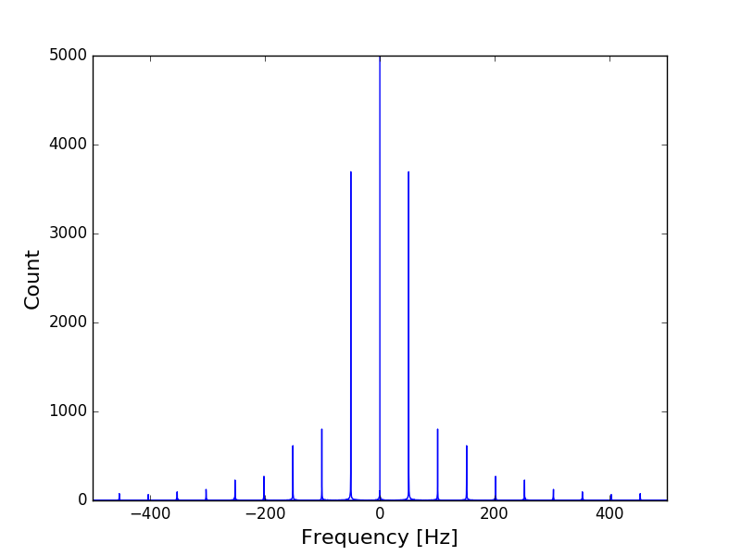

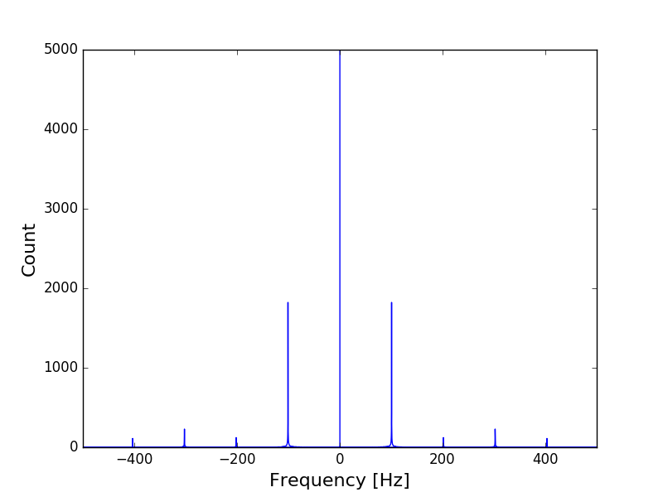
Reconstructions
Frequency | Sample Frame | Reconstructed FFT | Reconstructed Audio
44 Hz
50 Hz
100 Hz

Slide 12

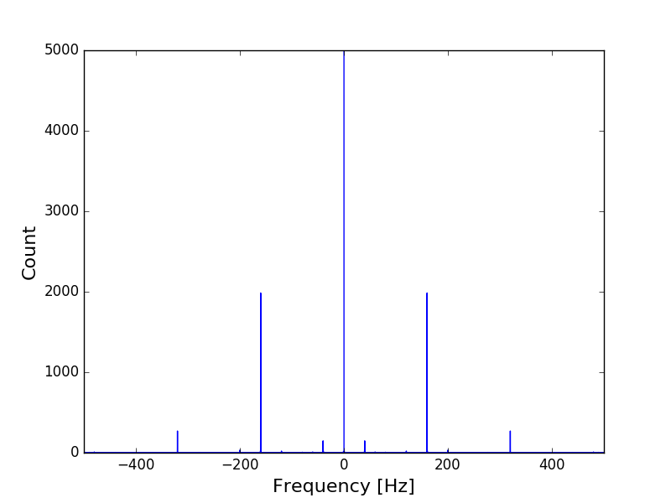

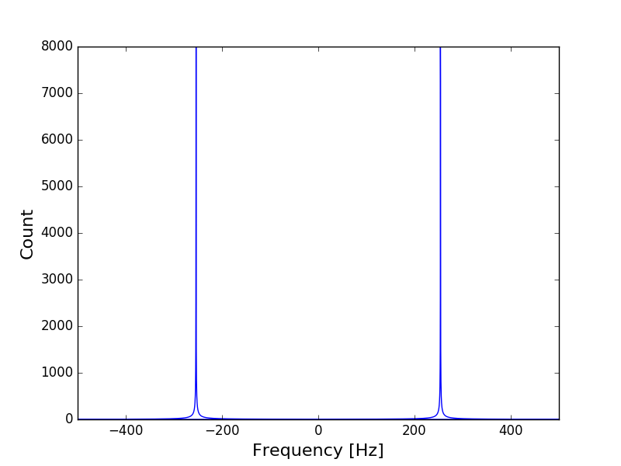

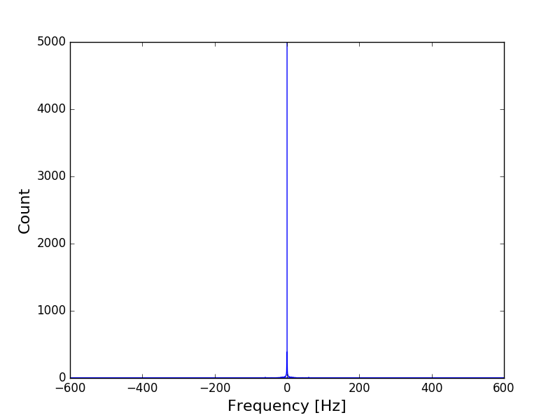
Reconstructions
Frequency | Sample Frame | Reconstructed FFT | Reconstructed Audio
160 Hz
250 Hz
500 Hz

Slide 13

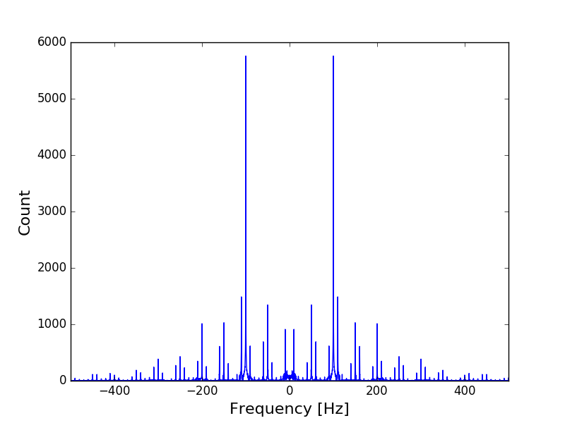

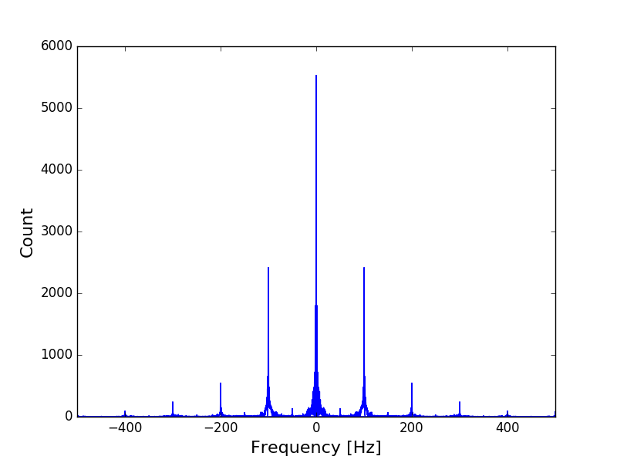
Reconstructions
Frequency | Sample Frame | Reconstructed FFT | Reconstructed Audio
50 Hz & 160 Hz
50 Hz & 160 Hz (Alternating)

Slide 14

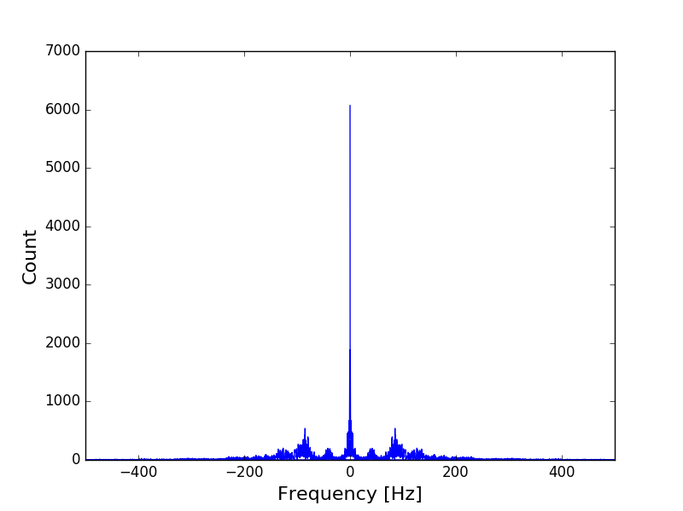
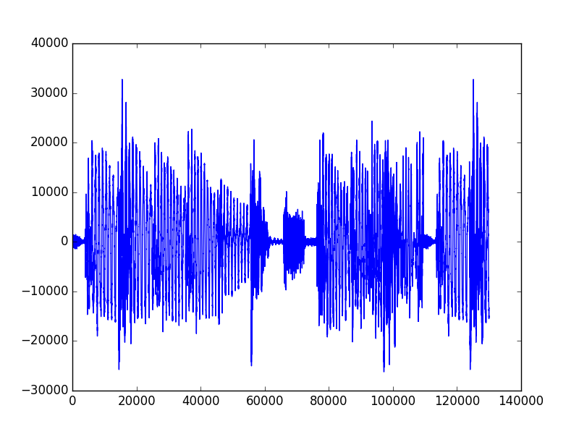
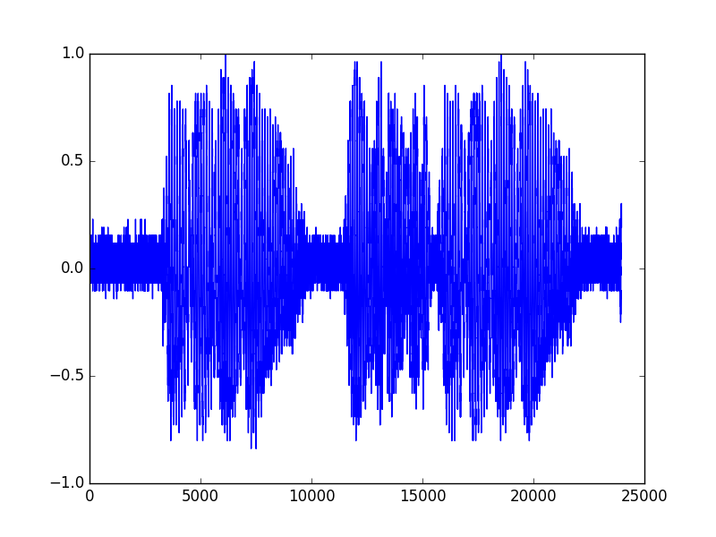
Music Reconstruction
Skrillex, for maximum base
Frequency | Sample Frame | Reconstructed FFT | Reconstructed Audio
Skrillex
Input Signal
Reconstructed Signal
Notes:
Skrillex – Fuck That (Bass Boosted).wav
Input and output signals, give or take some initial time delay in recording (on the right)

Slide 15
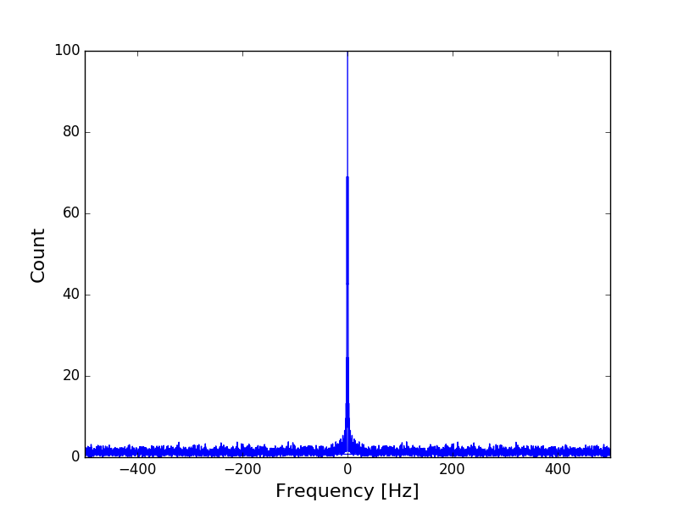
Speech Reconstruction
Human voice/throat rec (failed)
Notes:
Our issues were largely due to the fact that we could not focus properly with the camera, even with the lens, and there wasn’t enough light passing through the lens from our 2 LED cell phone flashlights. As the Visual Microphone paper found, even subtle single-pixel differences not visible to the naked eye can be amplified with the object in focus. The out-of-focus camera was able to pick up the speaker at low frequencies because the vibration amplitude was so substantial that it was visible even without focus. We believe that if we can use a 2D high-speed camera, where we can actually see if the throat is in focus or not, this experiment would be successful, even when measuring the throat.

Slide 16
Signal-to-Noise Ratio Analysis
Signal | SNR | SNR_{DB}
44 Hz | 0.0325 | -14.879
50 Hz | 1.5144e-5 | -48.198
100 Hz | 1.2829e-7 | -68.918
160 Hz | 0.0077 | -21.133
250 Hz | 0.0003 | -35.027
500 Hz | 8.0794e-9 | -80.926
50 Hz & 160 Hz | 0.0410 | -13.872
50 Hz & 160 Hz (Alternating) | 0.0109 | -19.619
Skrillex Music | 6.5326e-5 | -41.849
Notes:
SNR_db = 10 * log_{10} (P_orig / (P_rec – P_orig))
P = sum( |X[w]|^2 )

Slide 17
Conclusion
Summary, conclusion, takeaways
Things we would have done differently
Thank you to Professor Laura Waller, for the high-speed line-scan camera, and Professor Ren Ng, both of whom helped advise us on our project.

